Slide 1


Potential Spurs Off Season Moves
By: Moneeb Abu-Esba

Slide 2

Why The Spurs

Slide 3
Data
Salary
Positions
Current Rosters
Lineups
Free Agents
NBA Player Stats

Slide 4
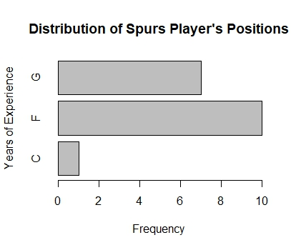
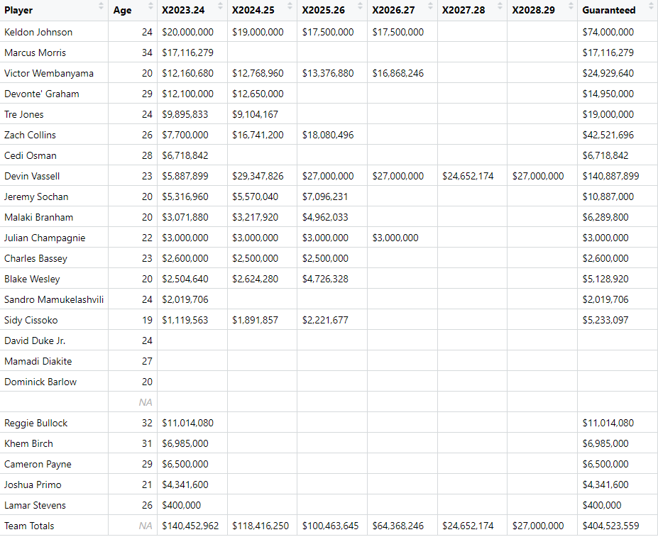
Deep Dive into the Spurs
Salary Cap
Positions
148,302,289-118,416,250
$29,886,039

Slide 5
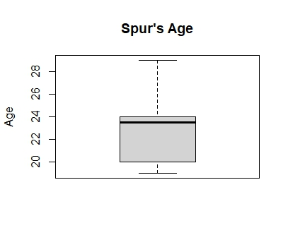
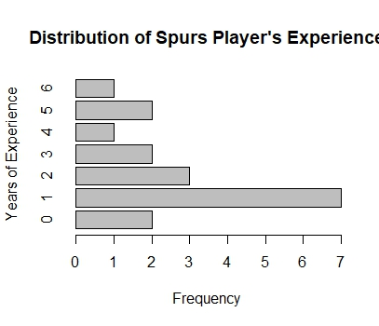
Spurs Today:

Slide 6
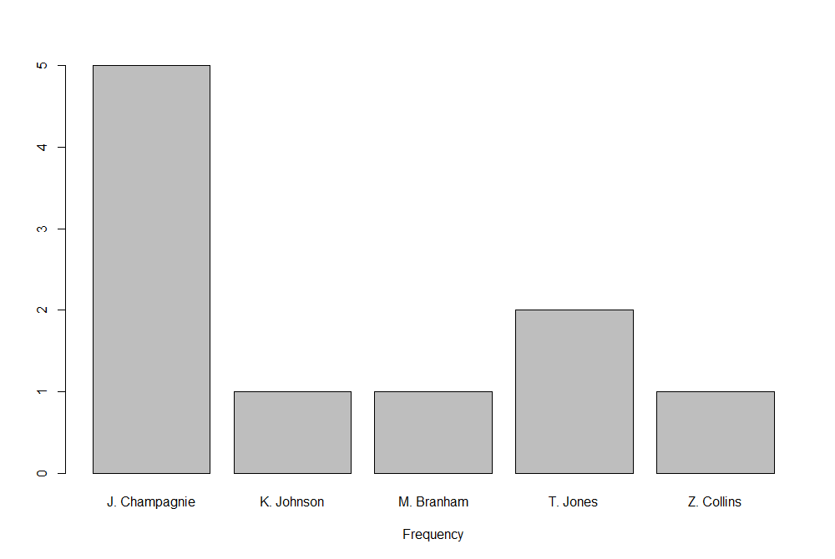
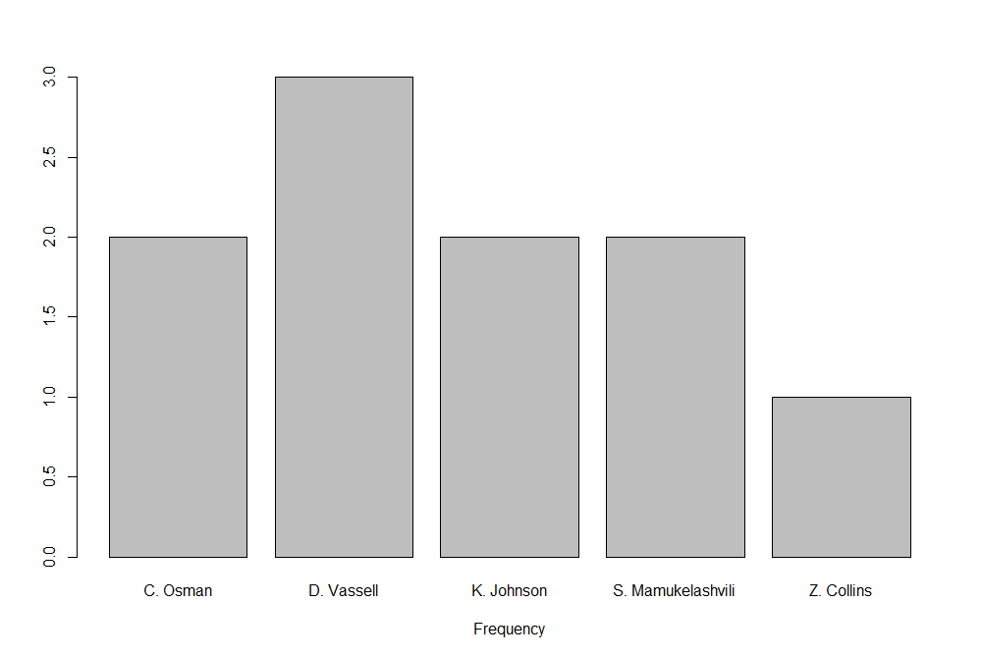
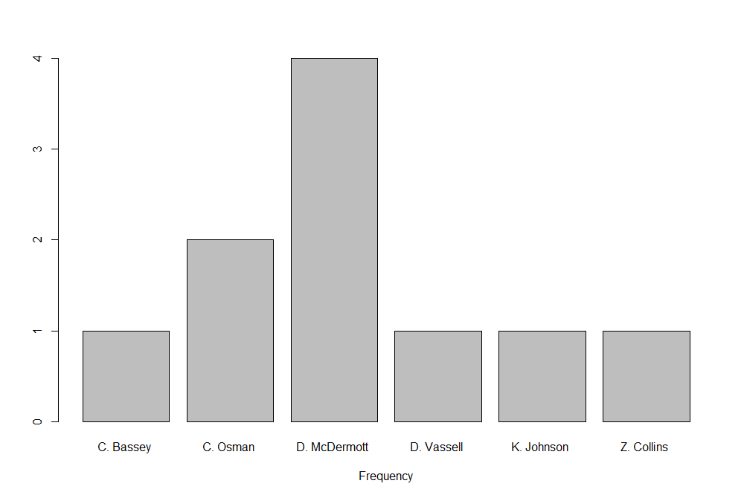
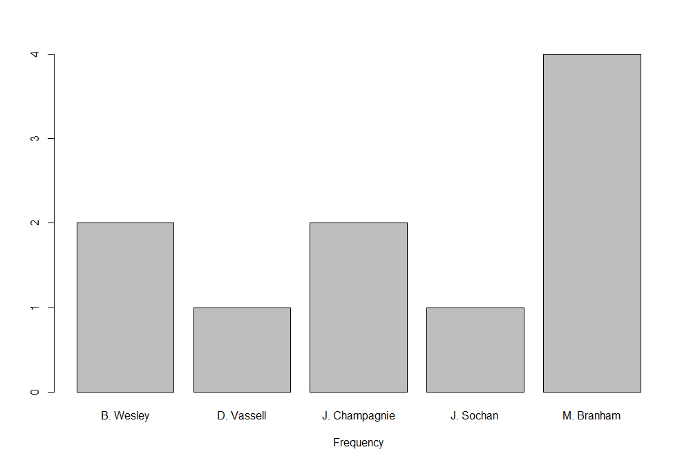
Top 10 Worst Points Lineups

Slide 7
Free Agents That Can Help
Guards:
Buddy Hield
Spencer Dinwiddie
Forwards:
Kelly Olynyk
DeMar DeRozan

Slide 8
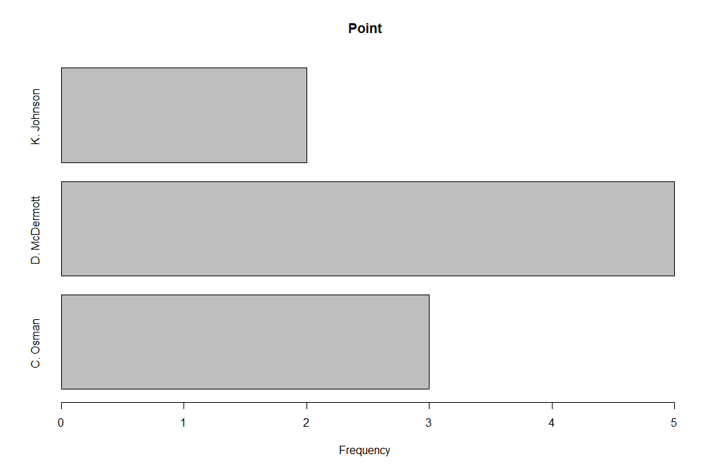
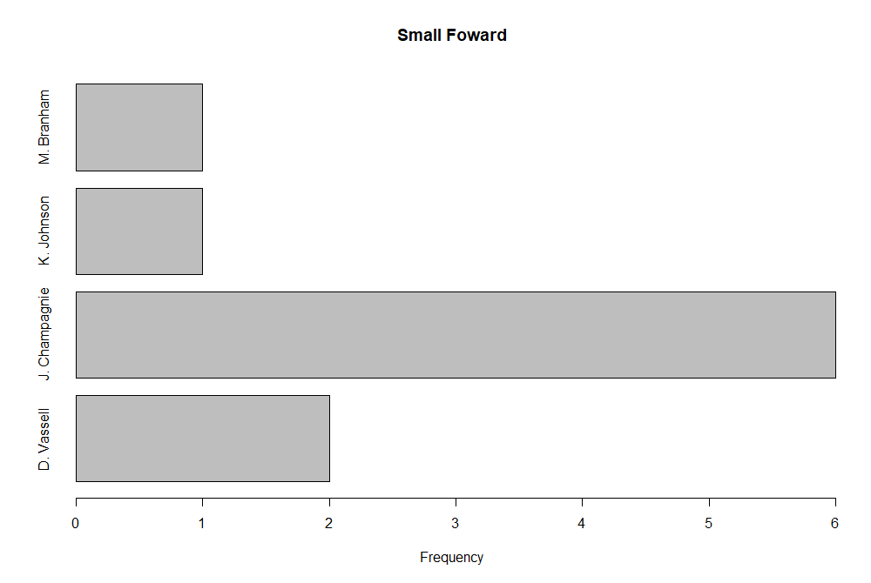
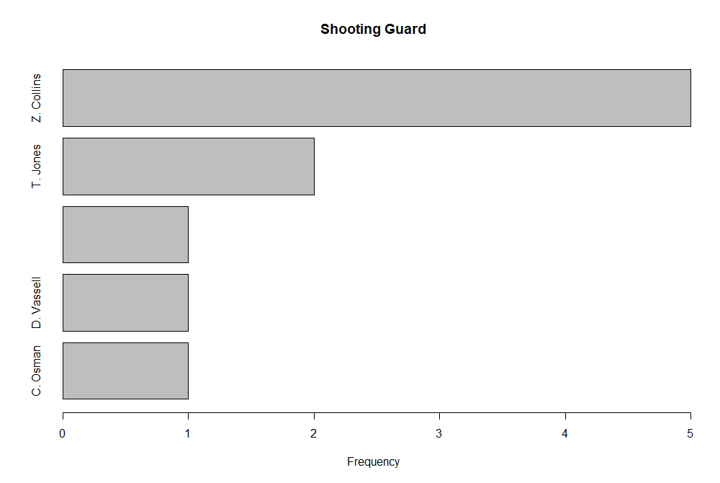
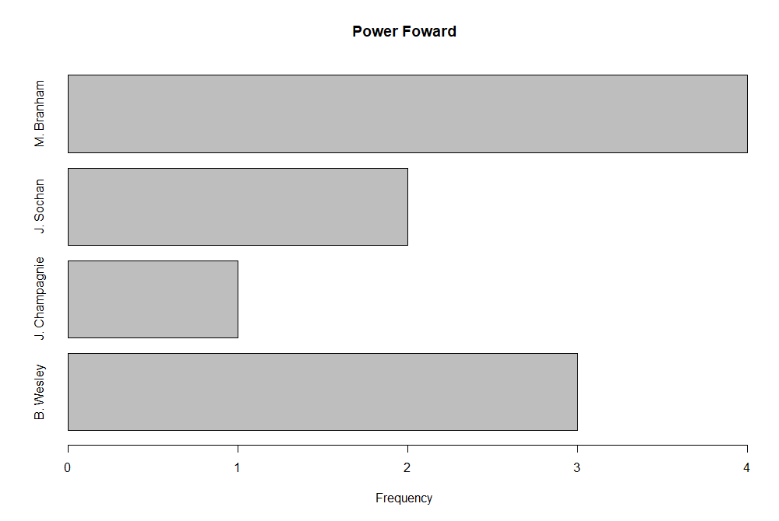
10 Worst Assist Lineups

Slide 9
Free Agents That Can Help
Guards:
Kris Dunn
Tyrus Jones
Forwards:
Miles Bridges
Naji Marshall

Slide 10
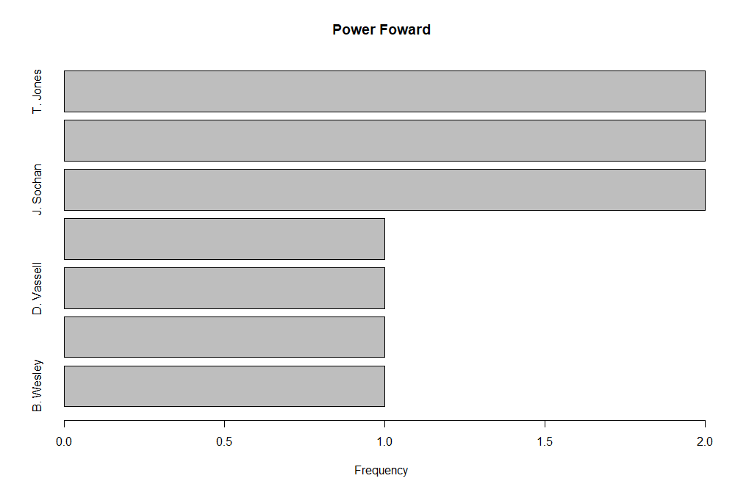
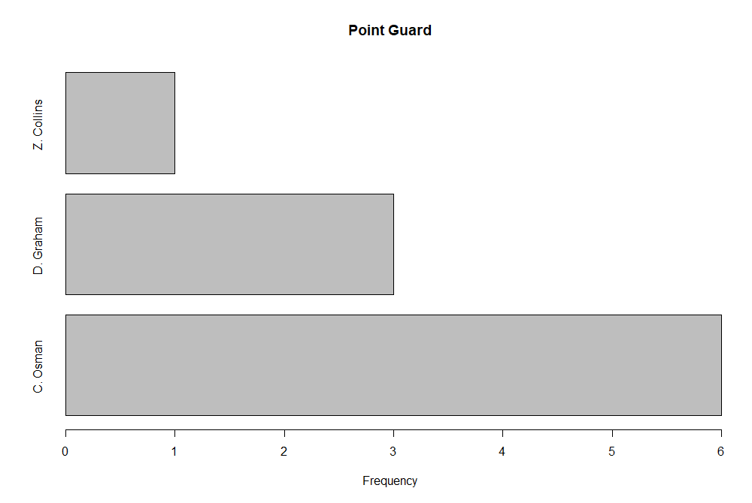
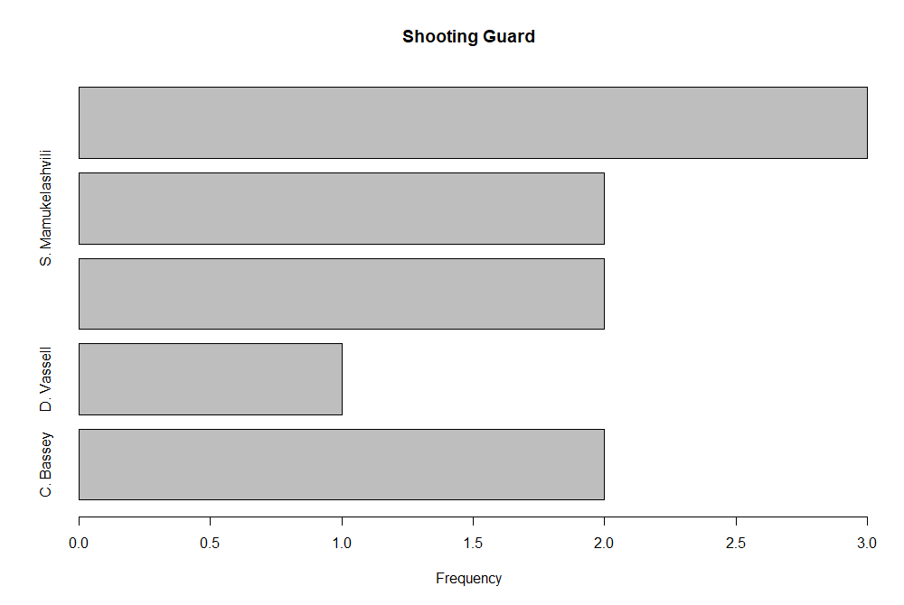
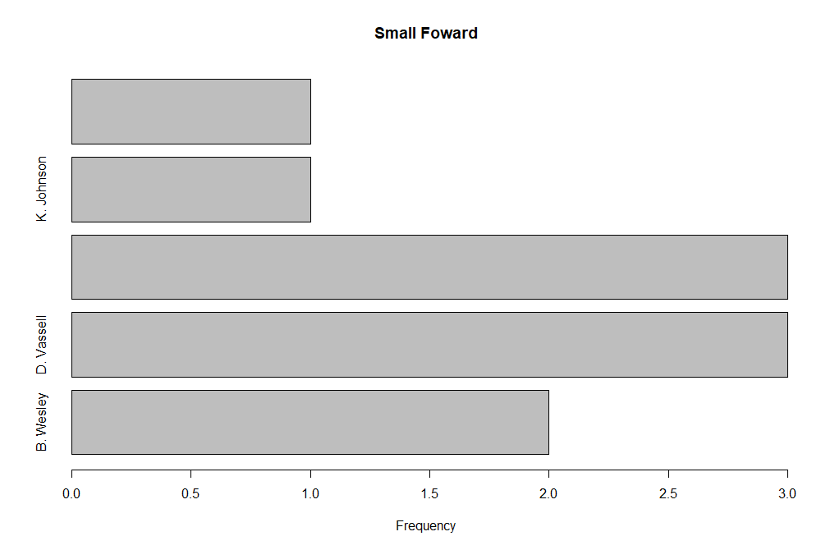
10 Worst Blocking Lineups

Slide 11
Free Agents That Can Help
Centers:
Nic Claxton
Andre Drummond
Forwards:
Royce O’Neale
Pascal Siakam

Slide 12

Conclusion
Spurs rotate young players around their lineups.
High Budget for the Off-Season
More opportunities that can be done.
NBA can not be explained with only numbers

